Slide 1
Afdharikaa E-Mart!!!
Presented by,
S.Kavipriya,
M.Afreen,
G.R.Dharanya.

Slide 2
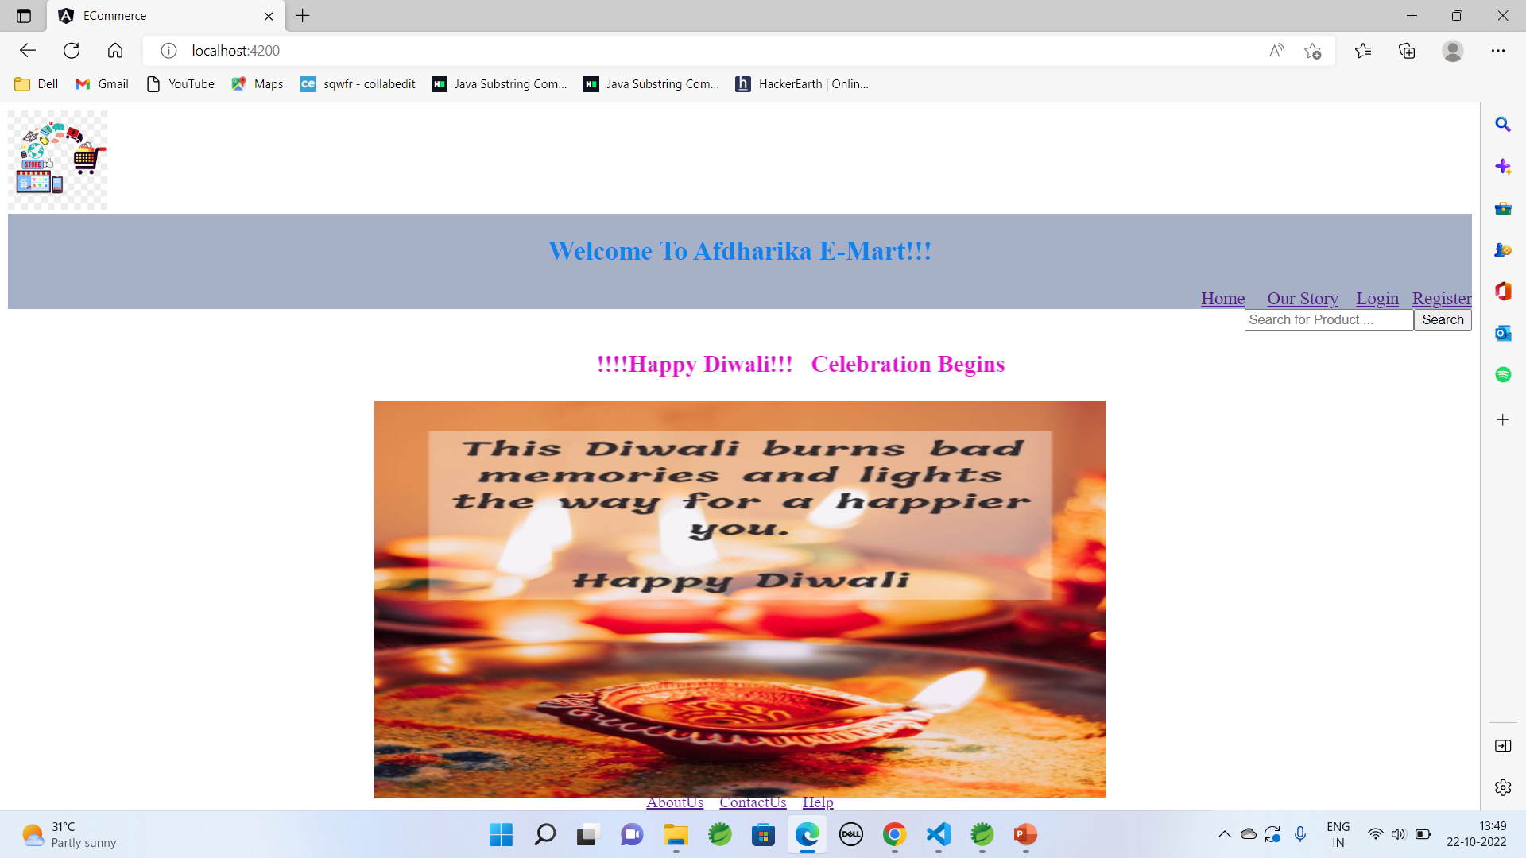
WELCOME PAGE

Slide 3
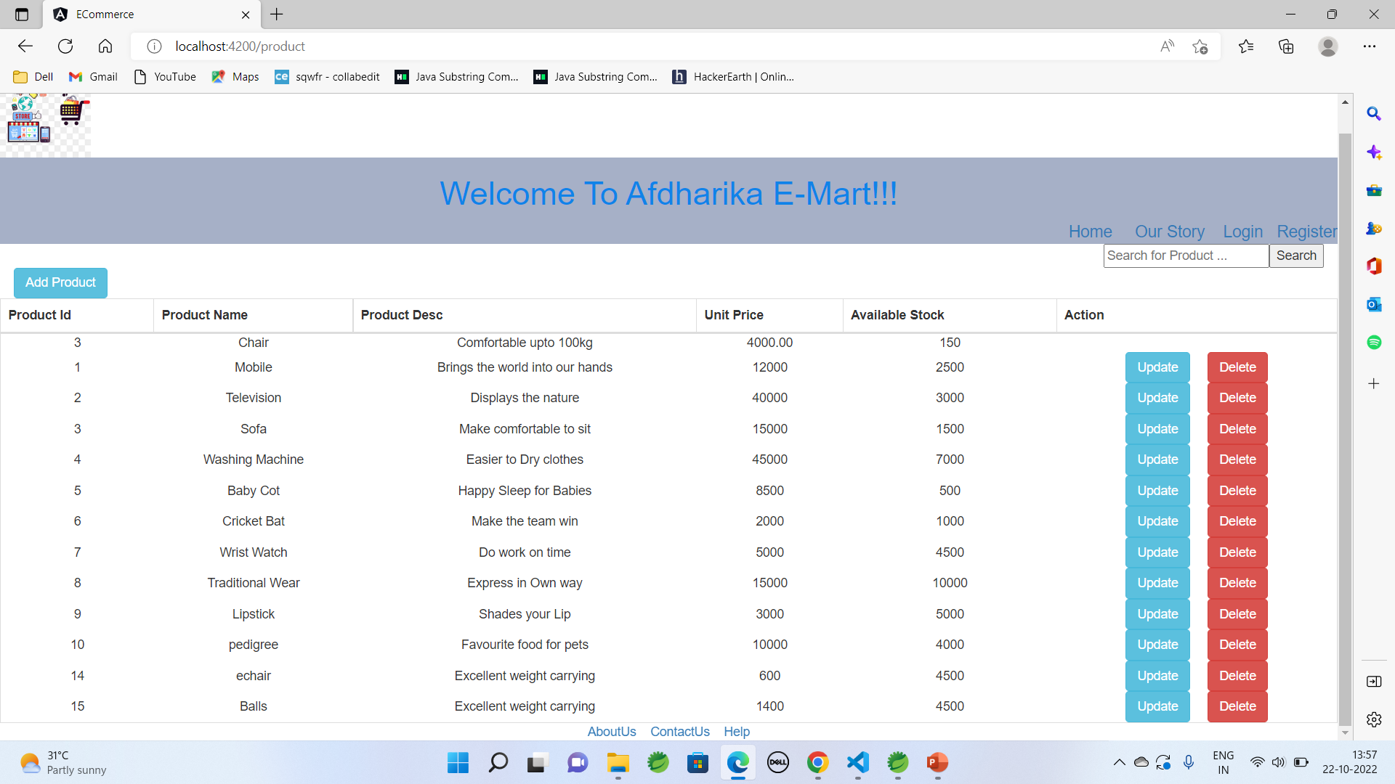
VIEW ALL PRODUCTS

Slide 4
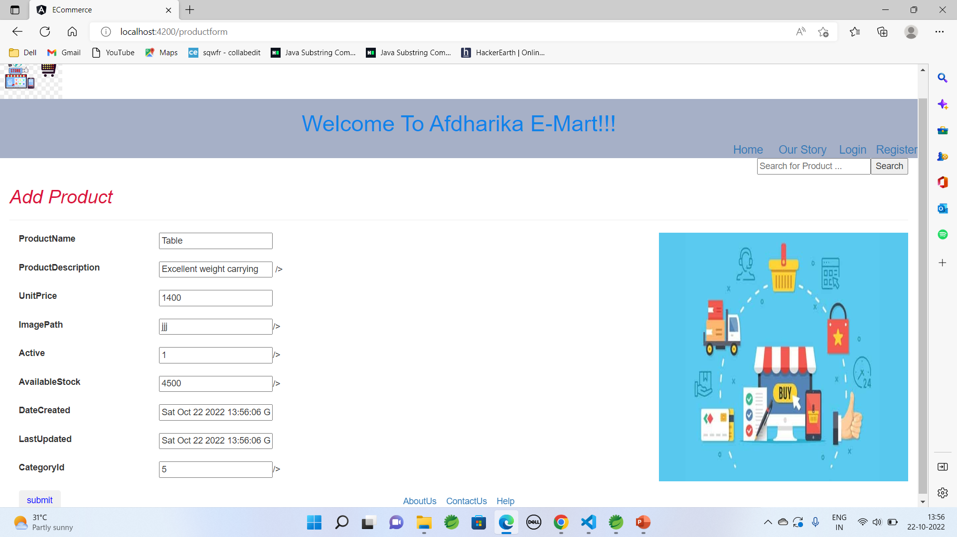
ADD PRODUCT

Slide 5
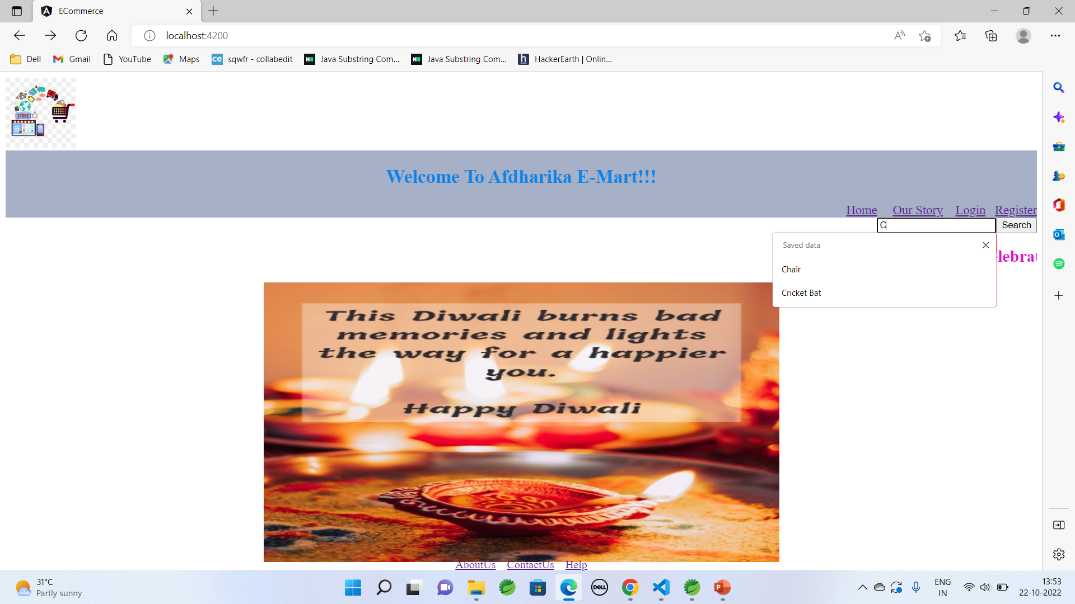
SEARCH PRODUCT BY NAME

Slide 6
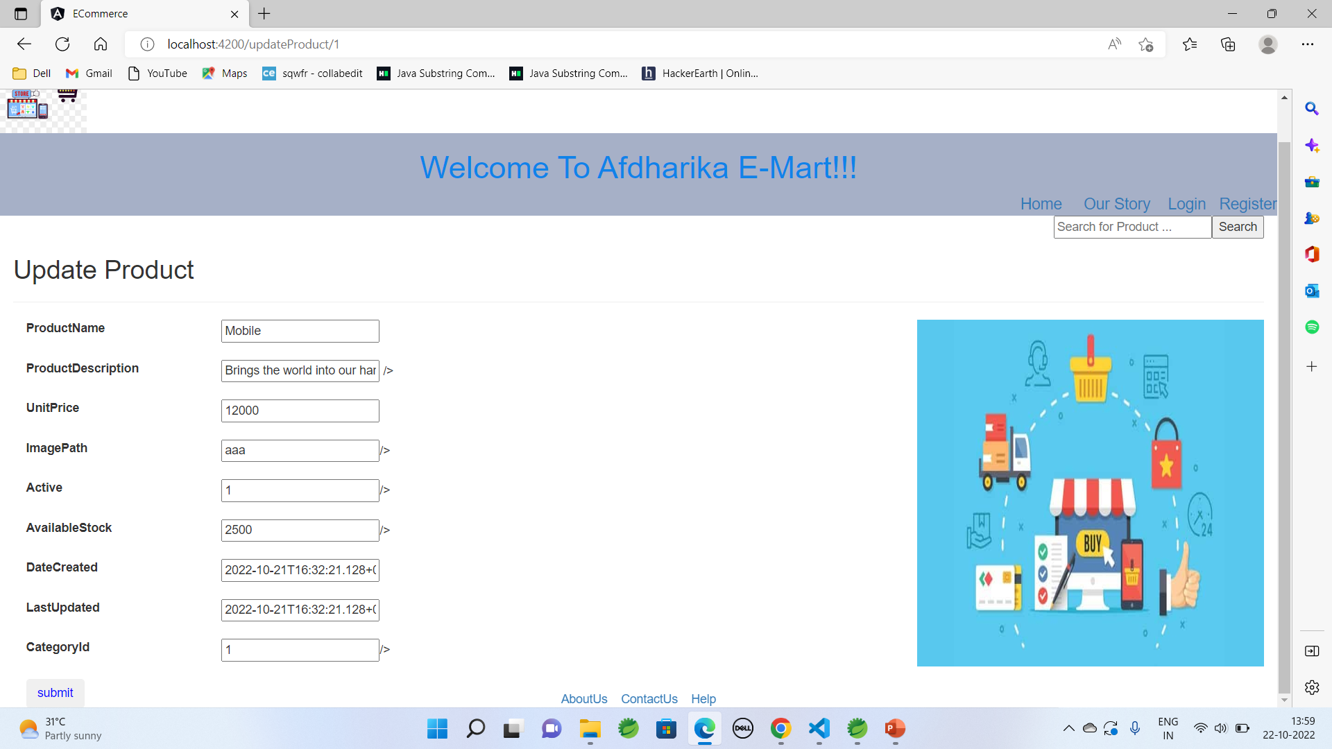
UPDATE PRODUCT

Slide 7
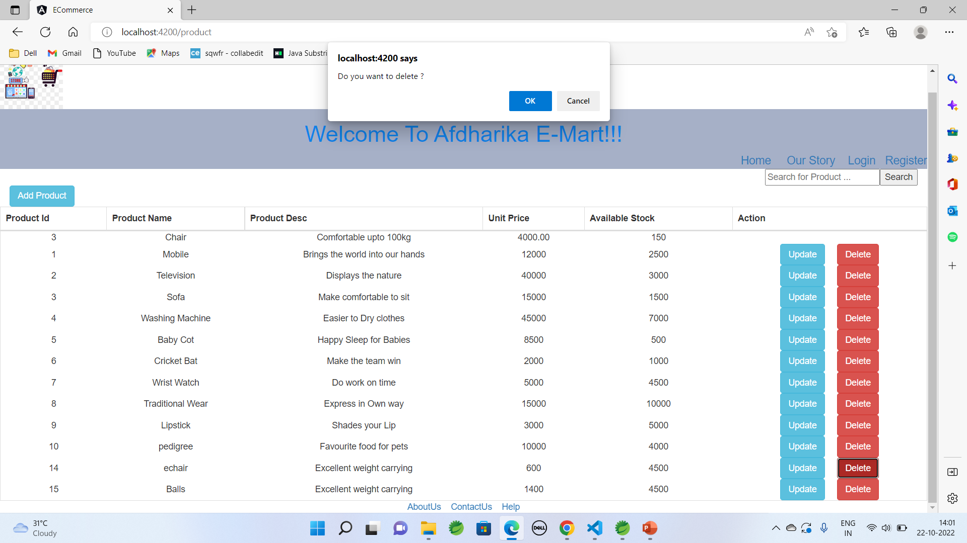
DELETE PRODUCT

Slide 8
THANK YOU….

